Slide 1
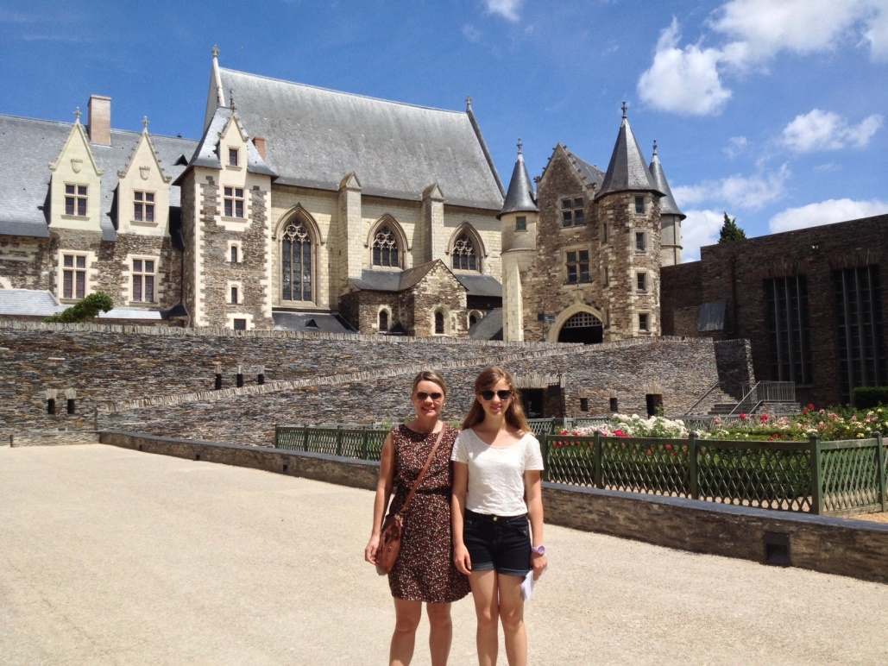
A presentation on life in Ireland, Belgium and Holland!

Slide 2
Who am I?
My name is Sophie O’Riordan
I am 15 years old
My dad is from Tipperary in Ireland, and my mum is from The Netherlands
I was born in Belgium and lived there for 13 years
I now live in Wicklow, Ireland for almost 3 years
I speak English, French, Dutch and some Irish!

Slide 3
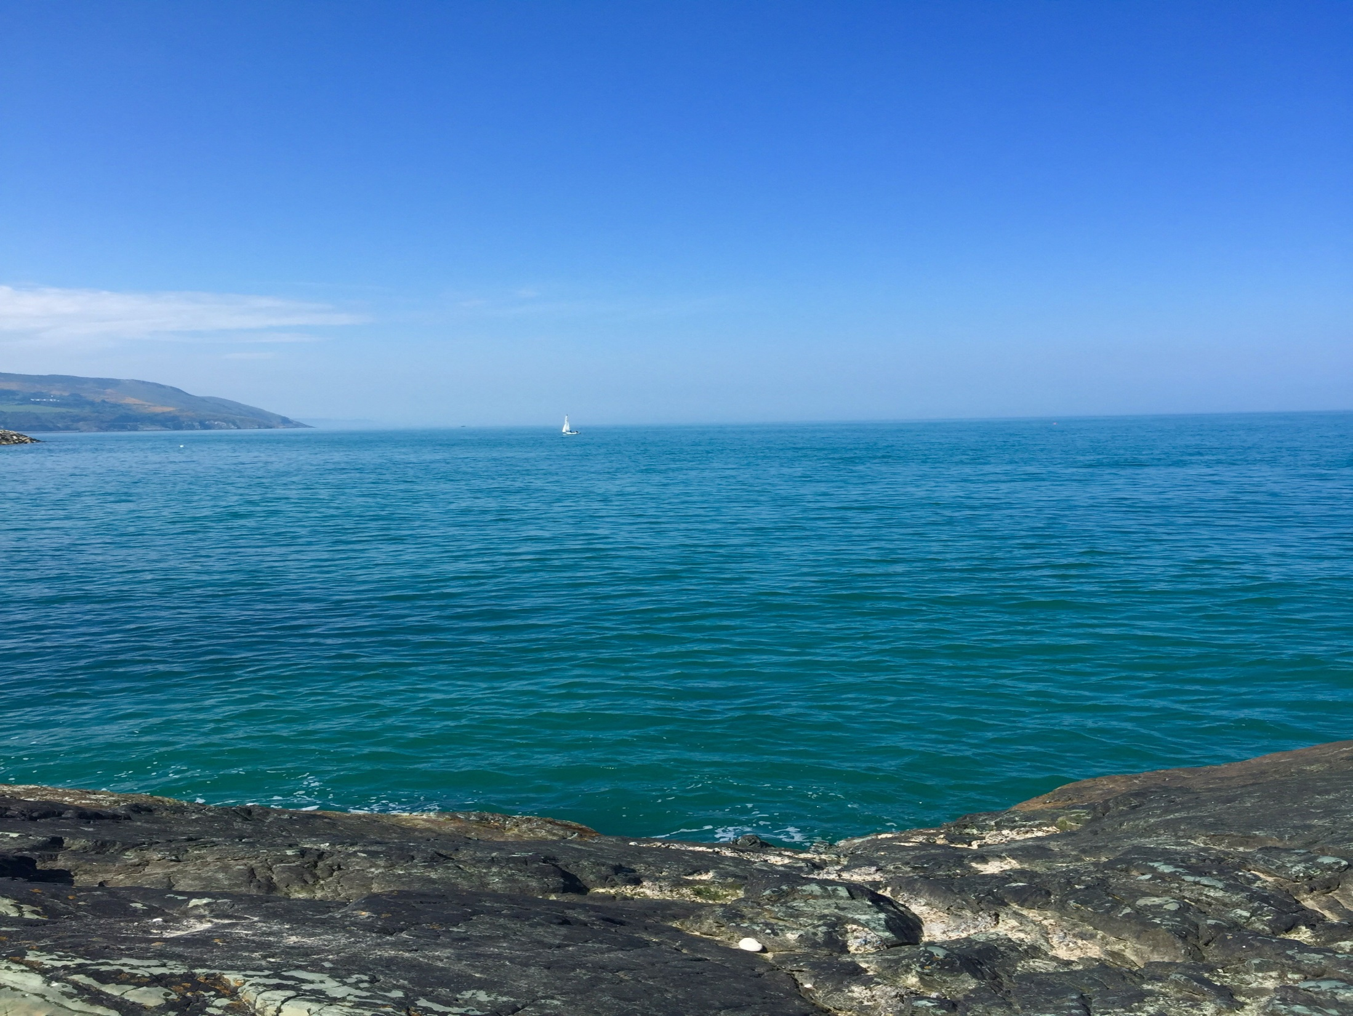
My interests and hobbies
My main hobby would be sports. I play hockey, football and tennis
As I live next to the sea, I enjoy cycling and walking along the beach
I love singing, playing piano and listening to music
My favourite TV programmes are: Friends, Downtown Abbey and NCIS
My favourite food is Indonesian Food
One of my favourite things to do is travel to different countries(especially France!)

Slide 4
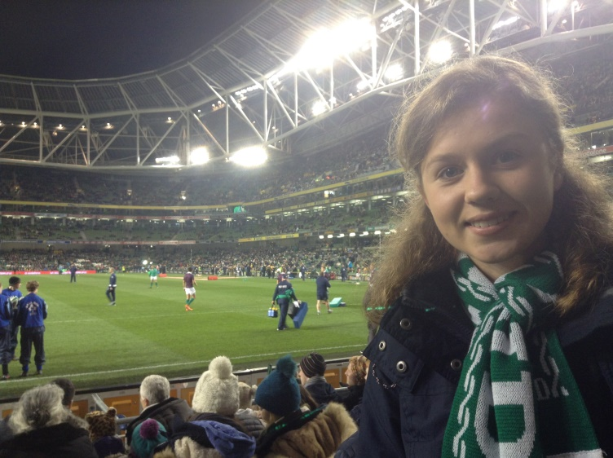
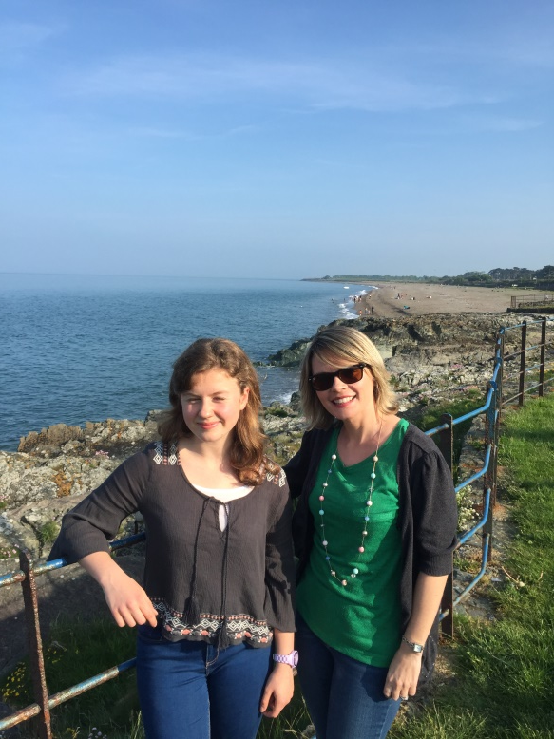
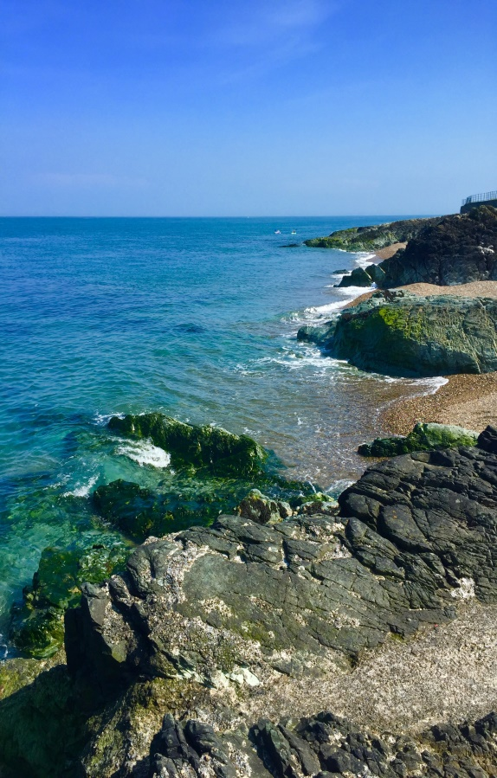
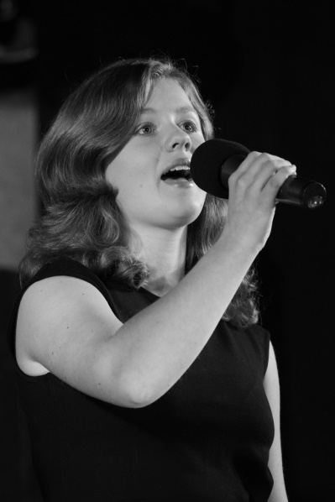
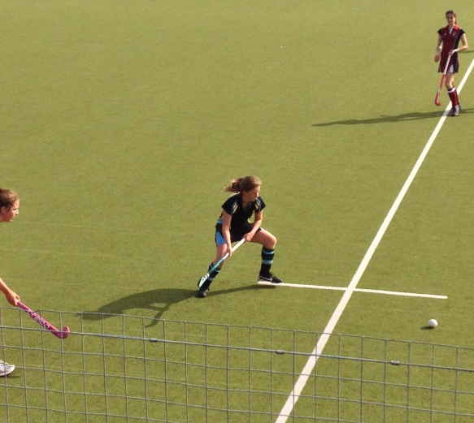
My Hobbies and interests!

Slide 5
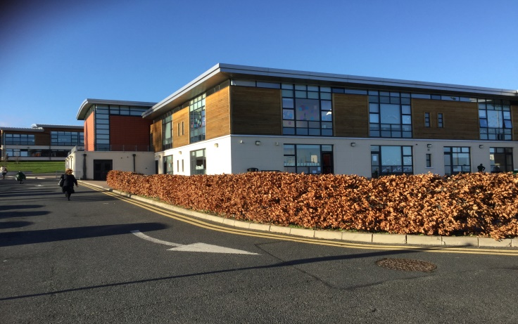
School in Ireland
I attend St Gerard’s School in Bray, Wicklow
https://video.search.yahoo.com/search/video?fr=mcafee_uninternational&p=st+gerards+from+the+sky#id=2&vid=cf0e425f52038917db30cf3784a826a8&action=click
It is a mixed school (boys and girls) and it has a primary and secondary school
We must all wear a uniform
There are 735 people in my school
The girls play hockey everyday after school
The boys play rugby, or some play football, also everyday
I have 9 classes a day, each 40 minutes and a 45 minute lunch
French Exchange students come to our school for a week in May
We have a European Languages week, where one day we eat French breakfast and speak French at school!

Slide 6
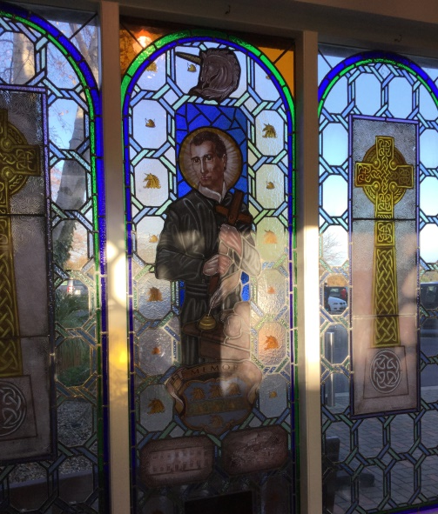
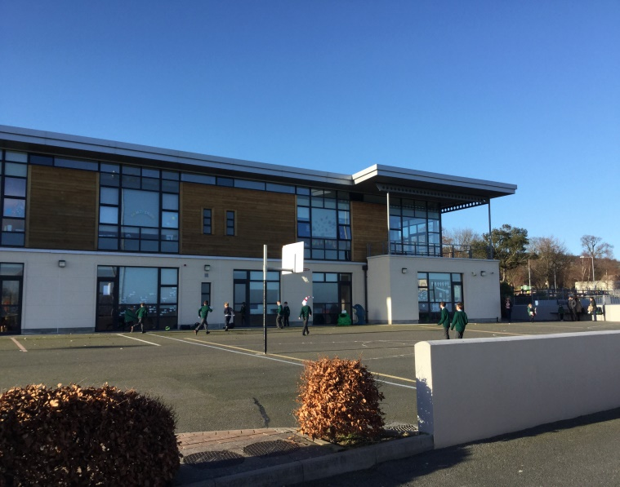
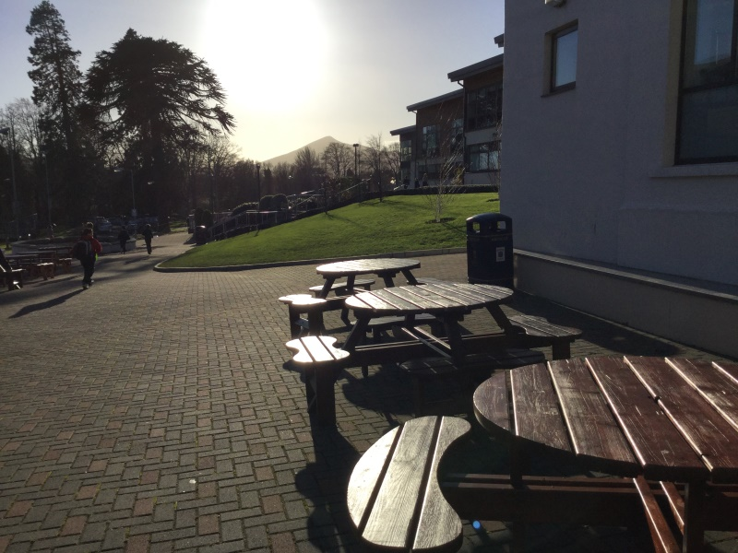
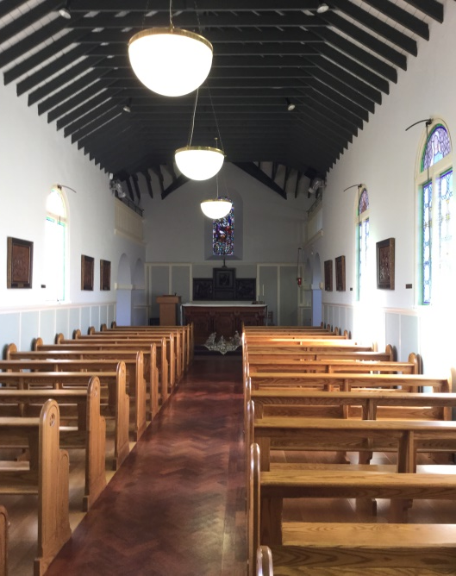
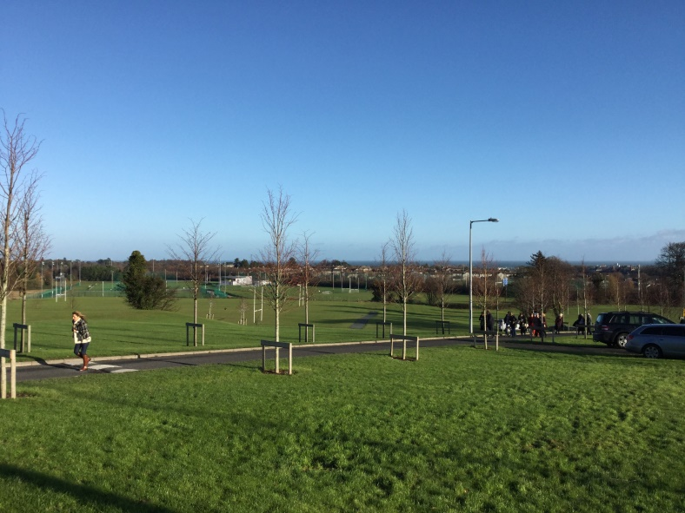
A few pictures of St. Gerard’s

Slide 7
Transition Year
I am in Fourth Year, also called Transition Year
It is a fun year with no exams. We do lots of activities and practical things to prepare us for the Leaving Cert and University
We go on many trips (camping, London, the Camino in Spain, Dublin, French Exchange)
We go to University Open days (Trinity college, DCU, UCD, Maynooth College and DIT)
We do a musical
We have the chance to do 3 weeks of Work Experience
We must create our own blog (website)
At the end of the year, the teachers interview us

Slide 8
My Transition Year Blog
http://sophieoriordantyblog.weebly.com/

Slide 9
Work Experience and Gaisce
We have 3 weeks of work experience. We can go anywhere we’d like to.
One week must be community service
I am doing: 1) University of Angers
2) Bray Lakers (sports and social place for people with disabilities)
3) Eco-Unesco in Dublin
We can also do a programme called Gaisce
I am doing 13 weeks of work in the library
13 weeks of a computer course (ECDL)
26 weeks of football at a girls’ football club

Slide 10
Subjects
In 3rd Year the whole of Ireland does a big exam called the Junior Cert
It is 3 weeks of exams on 3 year’s of work, in 11 subjects!
After the Junior Cert you must chose the subjects you want to take for your Leaving Cert (BAC)
I chose Maths, English, French, History, Business, Economics and Music
I am not quite sure what I would like to do in the future... I am interested in Business and Languages, or Interanational Relations

Slide 11
School in Belgium
I went to the European school of Woluwe in Belgium
There are 3500 people in this school
There is no uniform
There are 9 sections, each from a different European Country
There is a: English, French, German, Dutch, Swedish, Finnish, Italian, Portuguese and Lithuanian section
There is no obligatory sport after school, only PE during school
I chose to do football after school once a week and I did tennis outside of school
Every year the school celebrates footfest
https://www.youtube.com/watch?v=Q2Akqqb7aaM

Slide 12
Differences between school in Ireland and Belgium
Ireland | Belgium
Uniform | No uniform
School crest and motto | No crest or motto
Taught in English | Taught in over 9 languages
Must learn 2 languages | Must learn 3 languages
735 students | 3500 students
Lots of sports in school | Not much sports in school
Exams at Christmas and summer | Continious assessment (A and B tests)
Junior Cert and Leaving Cert | BAC
Skiing trip to Italy | Skiing trip to France
Transition Year | No Transition Year
6 years in secondary school | 7 years in secondary school
Must study christianity | Can chose which religion to study
Mass at school | No chapel or mass at school

Slide 13
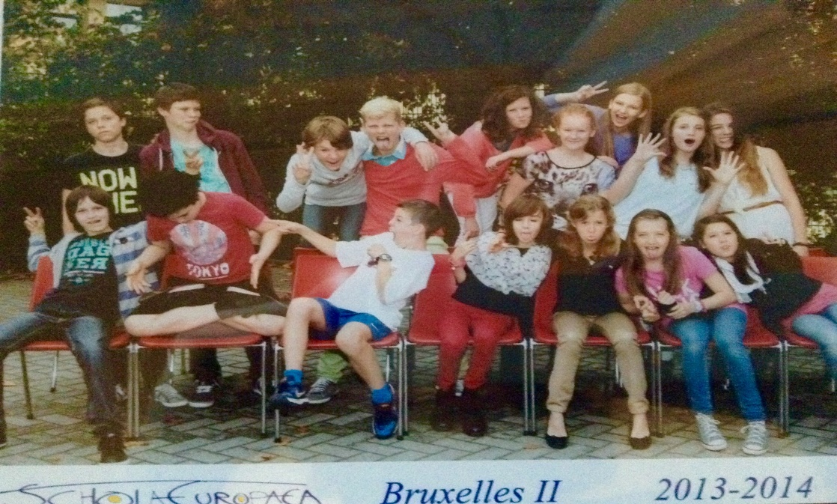
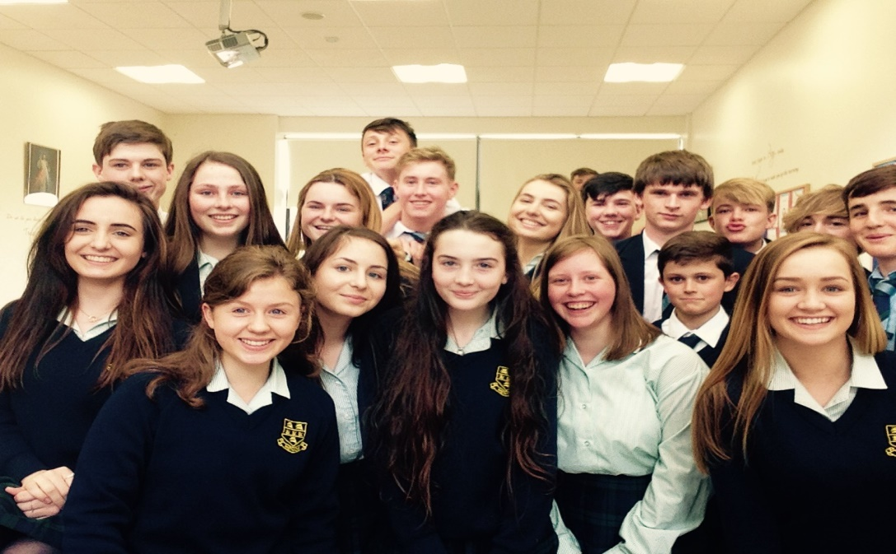
Which do I prefer?
Both school are very different, and great in their own ways!
However I prefer my school in Ireland because:
The campus is beautiful, with the sea and mountains around you
I love that we play a lot of sports
It is a smaller school, so you get to know everyone and the teachers better
There are many trips,events and quizes
Transition year is so much fun!
But, I do miss all the different languages and cultures around me at school

Slide 14
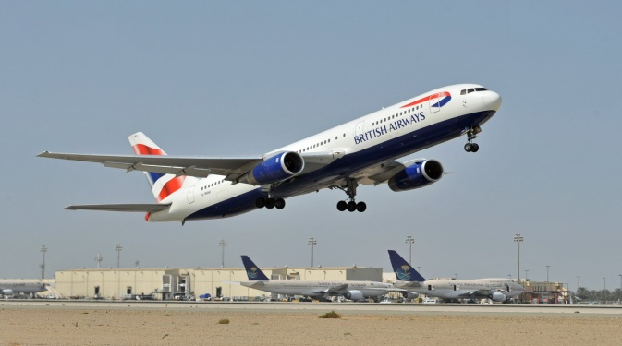
Travelling
I have travelled to: Spain, Italy, Holland, America, France, Germany, Austria, England, Scotland and Wales!
The first country I travelled to was Spain
My family has a house in Valencia, Spain so we go there at least twice a year
My granny and aunt lives in Holland; so we visit them very often
I have been skiing in Austria and France
In 2013 I visited America! I have 3 great-aunts in America, and a few second-cousins
One of my favourite holidays was this summer, when we went to Italy
I would like to travel to China, Malaysia, Australia, Greece, Brazil and many more countries!

Slide 15
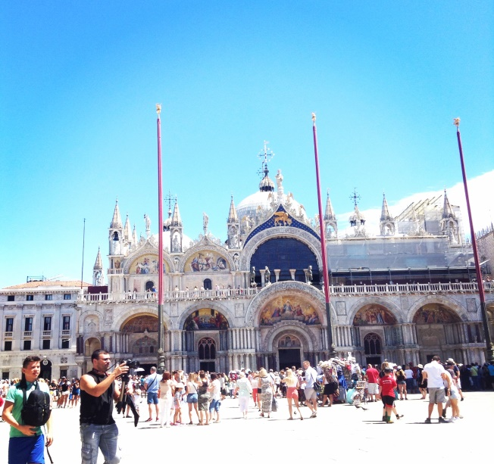
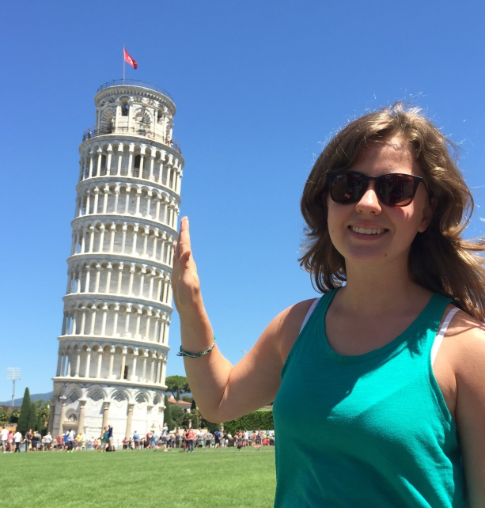
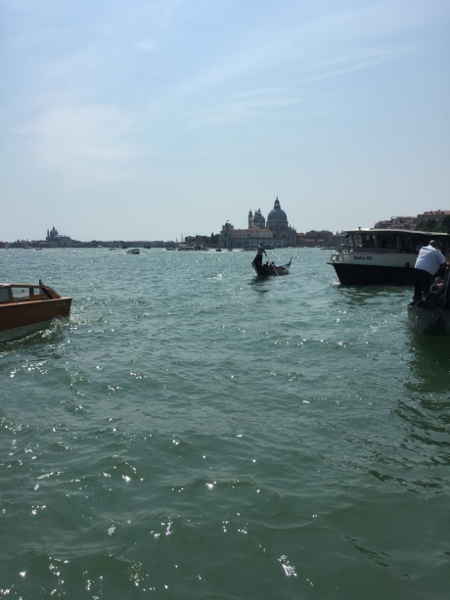
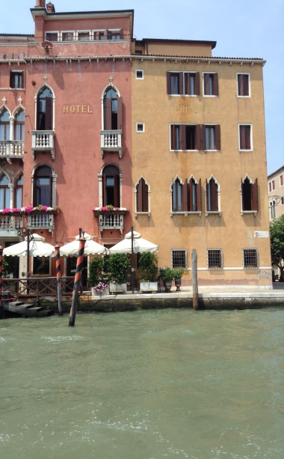
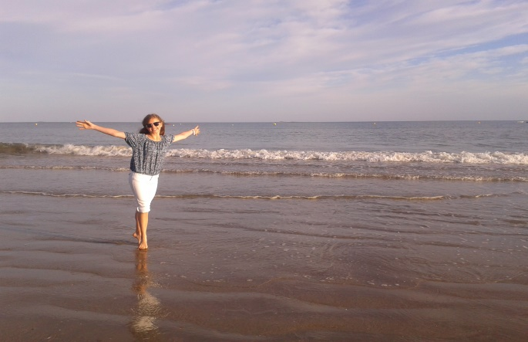
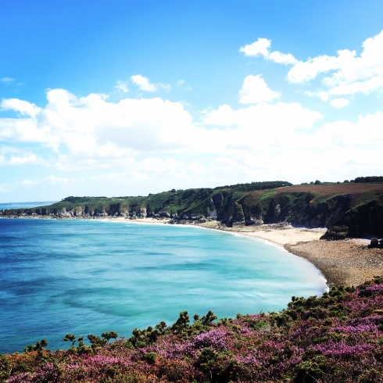
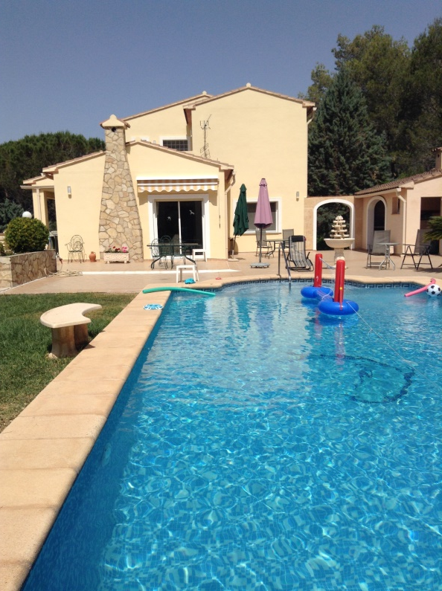
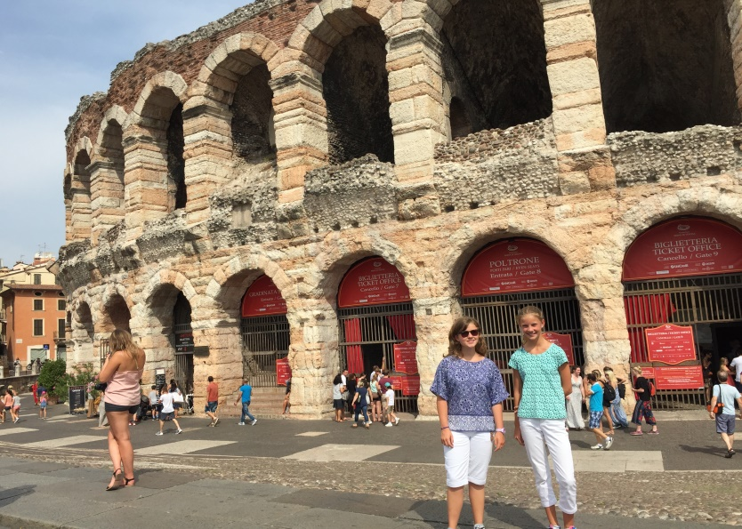
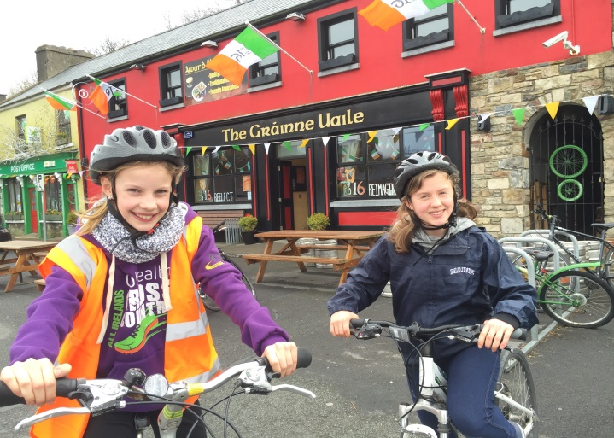

Slide 16
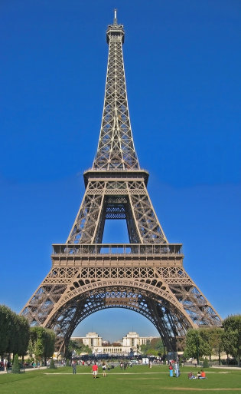
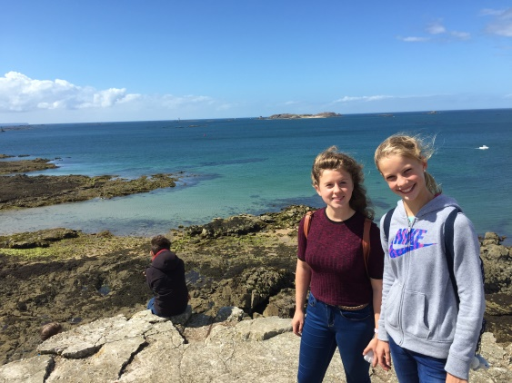
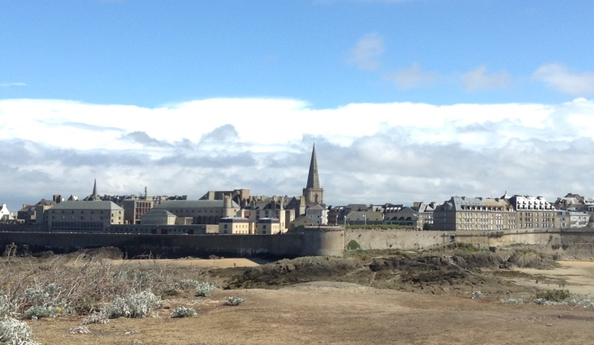
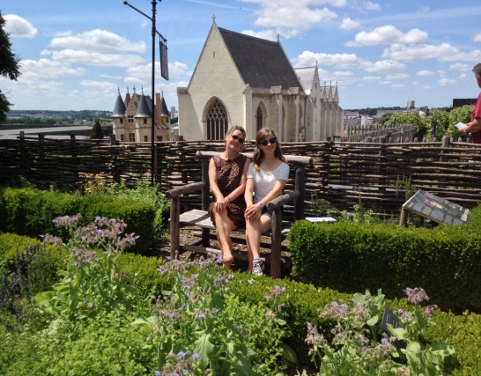
France
I really like France for many reasons:
I love the French language
It has beautiful cities, countryside and beaches
The food is delicious
France has good weather (better than Ireland!)
I have visited: Angers, Nantes, Paris, Valmenier, Bordeaux, Carcasonne, Brittany (Saint Malo, Dinan) and a few other places in France.

Slide 17
Thank you for your attention!
Merci pour votre attention!
Bedankt voor uw aandacht!
Go raibh maith agat!

