Slide 1
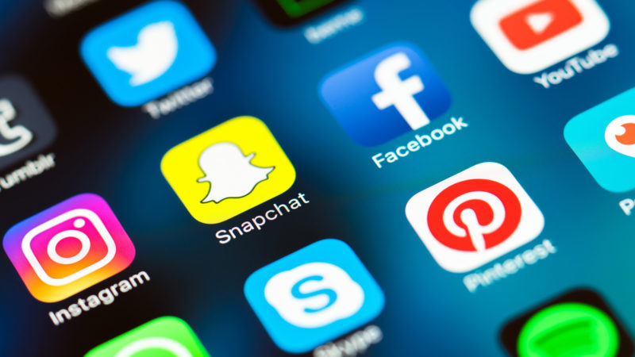
Social Media Does more harm than good
By Sophie O’Riordan

Slide 2
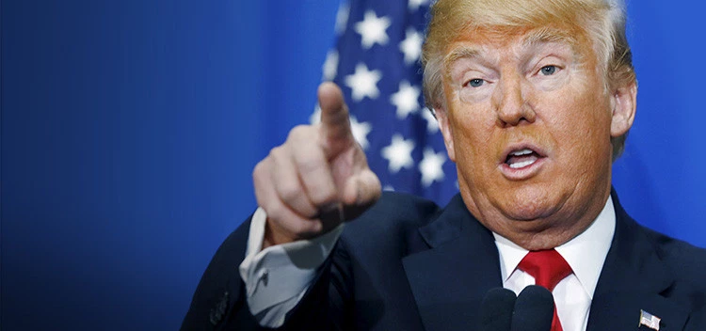
Real Friends or Just Acquaintances?
In a world of Trump and fake news, maybe the real crisis is fake friends

Slide 4
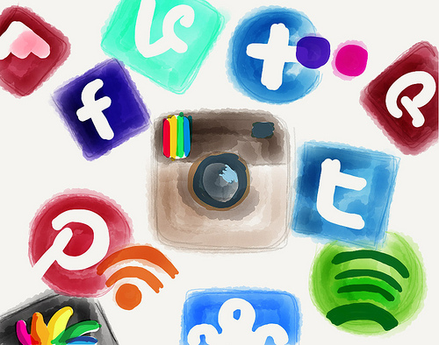
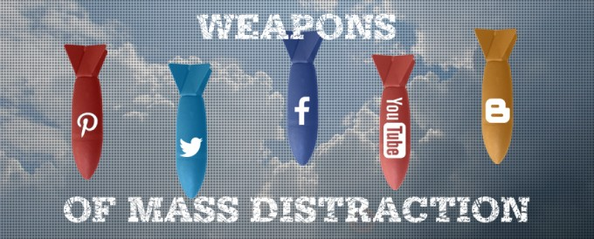
Productivity Killer
How many of you use social media at least once a day?
18% of users cannot go more than a few hours without checking Facebook
Over 60% feel compelled to check at least once a day

Slide 5
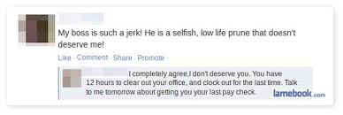
Professional Pitfall
Social Media can get you fired or stop you from being hired

Slide 6
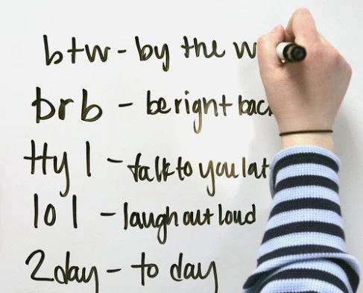
Grammar
Social Media is responsible for the deterioration of the English language

Slide 7
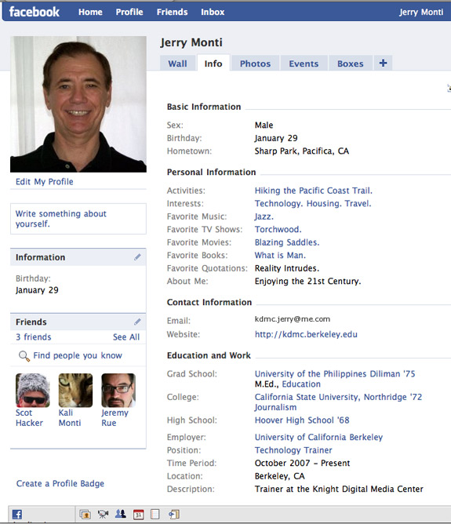
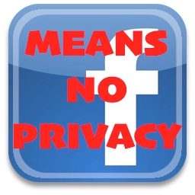
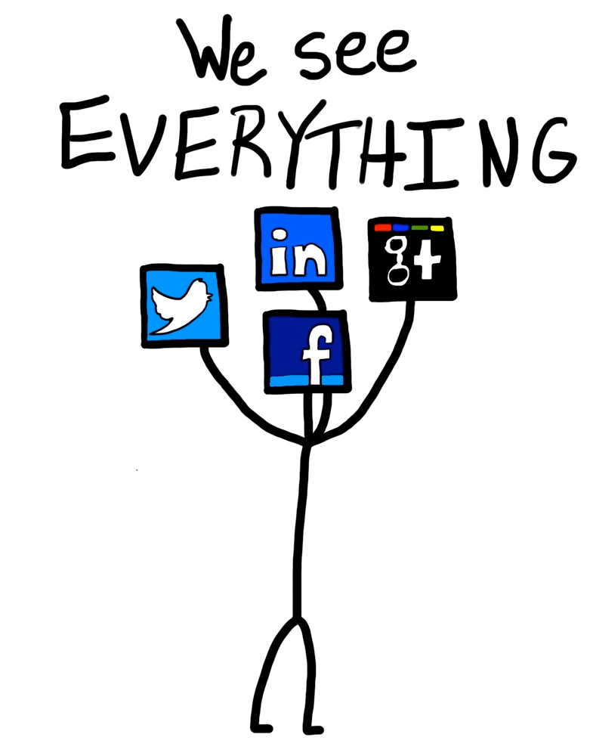
Privacy and Safety
Nearly 4 in 5 ex-burglers have indicated that thieves watch social media to look for potential opportunities

Slide 8
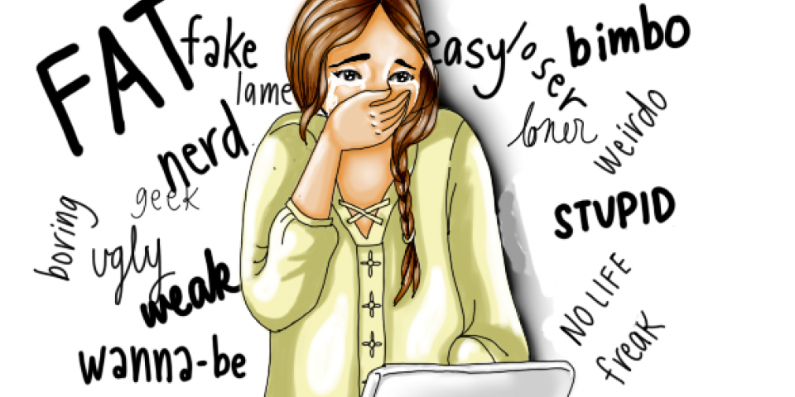
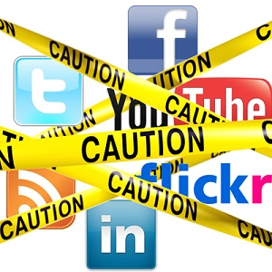
Cyberbullying
Cyberbullying victims are 5 times more likely to consider committing suicide

Slide 9
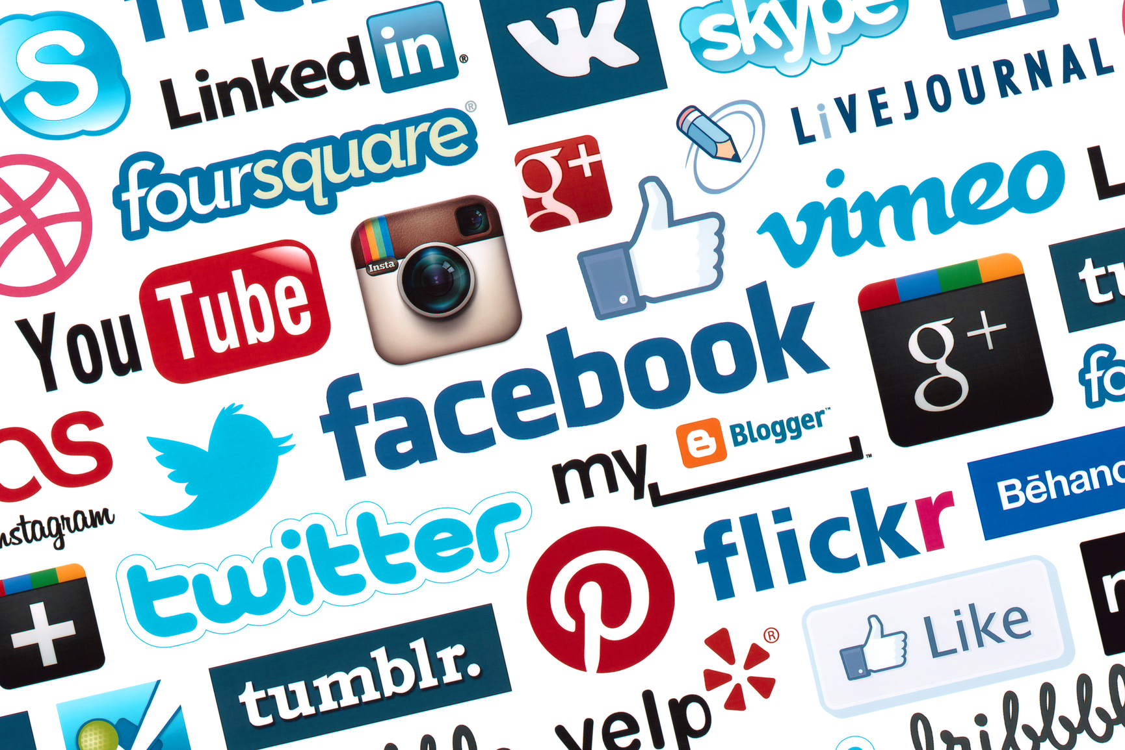
So, does Social Media do more harm than good?

